Slide 1
SEO for JavaScript Frameworks connecting the dots between your frameworks and CMS
Jamie Alberico
Notes:
Make sure you use the font, “Poppins” throughout this deck. You’ll have been sent this but can also download for free here: https://fonts.google.com/specimen/Poppins?selection.family=Poppins:100,100i,200,200i,300,300i,400,400i,500,500i,600,600i,700,700i,800,800i,900,900i

Slide 2
I’m Not a Robot but I speak bot.
I love working as a Technical SEO consultant embedded with development teams.
And playing D&D.
Jamie Alberico
Technical SEO Consultant @ Not a Robot
Notes:
This is your speaker bio page - we have individually designed images for each of you that we can add to these pages if you like.
Make sure you use the font, “Poppins” throughout this deck. You’ll have been sent this but can also download for free here: https://fonts.google.com/specimen/Poppins?selection.family=Poppins:100,100i,200,200i,300,300i,400,400i,500,500i,600,600i,700,700i,800,800i,900,900i

Slide 3
We’ve decided to rebuild the frontend.”
Notes:
Single line of copy as a statement into your next slide. You can emphasize a point in bold and dark purple (#3A0E55).
Make sure you use the font, “Poppins” throughout this deck. You’ll have been sent this but can also download for free here: https://fonts.google.com/specimen/Poppins?selection.family=Poppins:100,100i,200,200i,300,300i,400,400i,500,500i,600,600i,700,700i,800,800i,900,900i

Slide 4
in JavaScript
Notes:
Single line of copy as a statement into your next slide.
Make sure you use the font, “Poppins” throughout this deck. You’ll have been sent this but can also download for free here: https://fonts.google.com/specimen/Poppins?selection.family=Poppins:100,100i,200,200i,300,300i,400,400i,500,500i,600,600i,700,700i,800,800i,900,900i

Slide 5
75%
!
of product pages for an ecommerce site were not indexed in a case study by @TomkeRudzki
SourceL TechSEO Boost 2019: Research Competition Catalyst
Notes:
You can use the #F0F107 yellow as an accent for stats on the dark purple background.

Slide 7
Google uses Chromium to as its web rendering service.

Slide 8
=

Slide 9
Web Rendering Service (WRS)
Chromium Headless Browser
Google Magic
Blink Browser Engine
V8 Rendering Engine
Ignition
TurboFan
Liftoff
Display backend

Slide 10
“When we crawl your page with Googlebot, we go fetch the content and then we give it to chrome. Then Chrome runs all the scripts. It loads additional content.
Once everything's loaded we take a snapshot of the page and that's the content that actually gets indexed.”
- Erik Hendriks, Software Engineer at Google Rendering (WMConf MTV '19)
Notes:
Make sure you use the font, “Poppins” throughout this deck. You’ll have been sent this but can also download for free here: https://fonts.google.com/specimen/Poppins?selection.family=Poppins:100,100i,200,200i,300,300i,400,400i,500,500i,600,600i,700,700i,800,800i,900,900i

Slide 11
How it is then so much of our JS content slips between the cracks?

Slide 12
Let’s look at how search engines render.
Notes:
Single line of copy as a statement into your next slide.
Make sure you use the font, “Poppins” throughout this deck. You’ll have been sent this but can also download for free here: https://fonts.google.com/specimen/Poppins?selection.family=Poppins:100,100i,200,200i,300,300i,400,400i,500,500i,600,600i,700,700i,800,800i,900,900i

Slide 13
Assembly process without JavaScript
Crawl Queue
Crawler
Initial HTML
Crawled DOM
Processing
Index
Resources

Slide 14
Assembly with JavaScript
Crawl Queue
Crawler
List of scripts from our initial HTML

Slide 15
Assembly with JavaScript
Crawl Queue
Resources
Crawler
Crawled DOM
Render

Slide 16
Assembly with JavaScript
Crawl Queue
Resources
Crawler
Crawled DOM
Render
Rendered DOM

Slide 17
Assembly with JavaScript
Crawl Queue
Resources
Crawler
Crawled DOM
Render
Rendered DOM
Processing
Index

Slide 18
Crawled and Rendered DOMs together
Crawl Queue
Crawler
Crawled DOM
Render
Rendered DOM
Index
Resources
Processing

Slide 19
Let’s look at how JS frameworks work.
Notes:
Single line of copy as a statement into your next slide.
Make sure you use the font, “Poppins” throughout this deck. You’ll have been sent this but can also download for free here: https://fonts.google.com/specimen/Poppins?selection.family=Poppins:100,100i,200,200i,300,300i,400,400i,500,500i,600,600i,700,700i,800,800i,900,900i

Slide 20
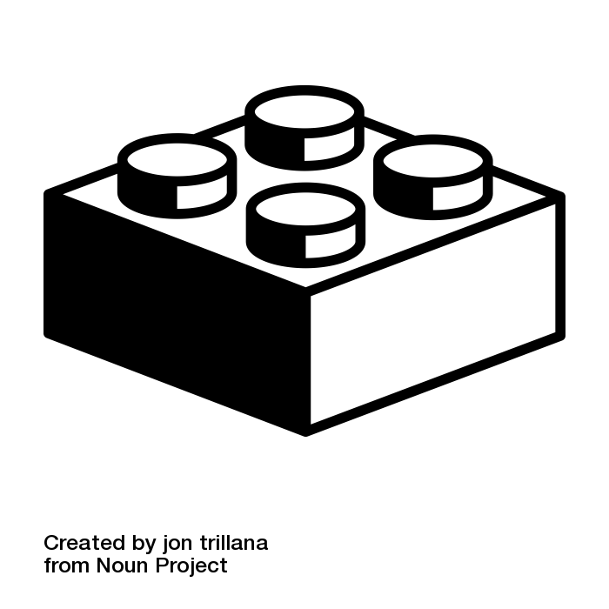
JavaScript frameworks use components.
Components are cohesive, reusable and modular.
Components assemble to make a template
{ headline }
{ text}
image
Notes:
build a template out of components

Slide 21
{
"pun":"Why did the dev go broke?"
"punchline":"Because he used up all his cache"
"image":"meme.jpg"
}
{ pun }
{ punchline}
{image}

Slide 22
How do you comfort a JS bug?
You console it.
Notes:
build a template out of components

Slide 23
{
"prodName":"Product 1"
}
{ prodName }
{
"prodName":"Product 2"
}
{ price}
BUY
{ prodDescription}
{
"prodName":"Product 3"
}
Notes:
build a template out of components

Slide 24
JavaScript frameworks come in many flavors.
Notes:
Single line of copy as a statement into your next slide. You can emphasize a point in bold and dark purple (#3A0E55).
Make sure you use the font, “Poppins” throughout this deck. You’ll have been sent this but can also download for free here: https://fonts.google.com/specimen/Poppins?selection.family=Poppins:100,100i,200,200i,300,300i,400,400i,500,500i,600,600i,700,700i,800,800i,900,900i

Slide 25
Angular | Greenery | Prototype
AngularJS | JavaScriptMVC | PureMVC
Wakanda | qooxdoo | JsRender/JsViews
Cappuccino | Knockout | React.js
Chaplin | Ember | Sapper
Echo | Mojito | SproutCore
Meteor | MooTools | Vue.js
Enyo | Armadillo | Backbone.js
Express | OpenUI5 | Preact
Ext JS | Polymer | Svelte

Slide 26
None are inherently good or bad.
It’s how we use them.
Notes:
Single line of copy as a statement into your next slide. You can emphasize a point in bold and dark purple (#3A0E55).
Make sure you use the font, “Poppins” throughout this deck. You’ll have been sent this but can also download for free here: https://fonts.google.com/specimen/Poppins?selection.family=Poppins:100,100i,200,200i,300,300i,400,400i,500,500i,600,600i,700,700i,800,800i,900,900i

Slide 27
As SEOs we ultimately care how JS frameworks are assembled.
Notes:
Single line of copy as a statement into your next slide.
Make sure you use the font, “Poppins” throughout this deck. You’ll have been sent this but can also download for free here: https://fonts.google.com/specimen/Poppins?selection.family=Poppins:100,100i,200,200i,300,300i,400,400i,500,500i,600,600i,700,700i,800,800i,900,900i

Slide 28
We have options.
Some are better than others.
Notes:
Single line of copy as a statement into your next slide. You can emphasize a point in bold and dark purple (#3A0E55).
Make sure you use the font, “Poppins” throughout this deck. You’ll have been sent this but can also download for free here: https://fonts.google.com/specimen/Poppins?selection.family=Poppins:100,100i,200,200i,300,300i,400,400i,500,500i,600,600i,700,700i,800,800i,900,900i

Slide 29
A request is made to your site

Slide 30
<!doctype html>
<head>
<script type="text/javascript" src="/main.js?ver=1.1.0"> </script>
</head>
<body>
<app-root></app-root>
</body>
</html>
Client Side Render

Slide 31
<!doctype html>
<head>
<title>Hello, TTTL
</head>
<body>
<h1>Wait.This isn’t Miami</h1>
<p>Wash your hands.</p>
</body>
</html>
Server Side Render

Slide 32
Prerender

Slide 33
<!doctype html>
<head>
<title>Hello, TTTL</title>
<link rel="shortcut icon" href="//favicons/favicon-32x32.png" type="image/png" />
<link rel="canonical" href="https://www.perforce.com/blog/vcs/component-based-development" />
<!doctype html>
<head>
<script type="text/javascript" src="/main.js?ver=1.1.0"> </script>
</head>
<body>
<app-root></app-root>
</body>
</html>
Dynamic Rendering

Slide 34
<!doctype html>
<head>
<title>Hello, TTTL
</head>
<body>
<h1>I render content in the initial viewport server side!</h1>
<script type="text/javascript" src="/main.js?ver=1.1.0"> </script>
</body>
</html>
Isomorphic Render

Slide 35
Alright, now let’s break our rendering strategies.
Notes:
Single line of copy as a statement into your next slide.
Make sure you use the font, “Poppins” throughout this deck. You’ll have been sent this but can also download for free here: https://fonts.google.com/specimen/Poppins?selection.family=Poppins:100,100i,200,200i,300,300i,400,400i,500,500i,600,600i,700,700i,800,800i,900,900i

Slide 36
<!doctype html>
<head>
<script type="text/javascript" src="/main.js?ver=1.1.0"> </script>
</head>
<body>
<app-root></app-root>
</body>
</html>
Client Side Render

Slide 37
Each script has a probability to fail.
<rel="buyproduct.js"> = 99.5% success rate
Notes:
Single line of copy as a statement into your next slide. You can emphasize a point in bold and dark purple (#3A0E55).
Make sure you use the font, “Poppins” throughout this deck. You’ll have been sent this but can also download for free here: https://fonts.google.com/specimen/Poppins?selection.family=Poppins:100,100i,200,200i,300,300i,400,400i,500,500i,600,600i,700,700i,800,800i,900,900i

Slide 38
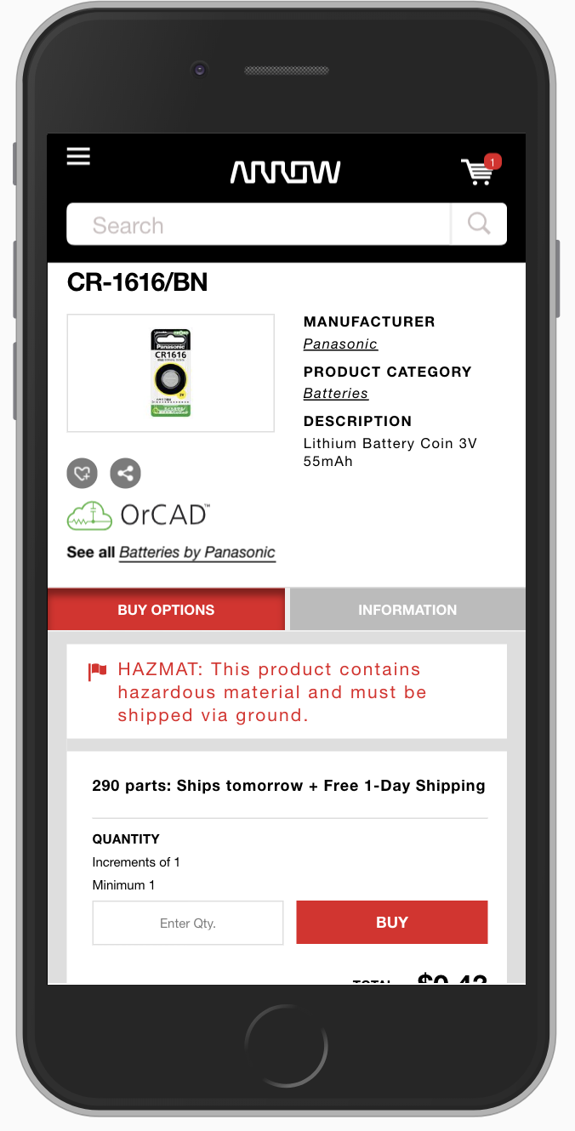
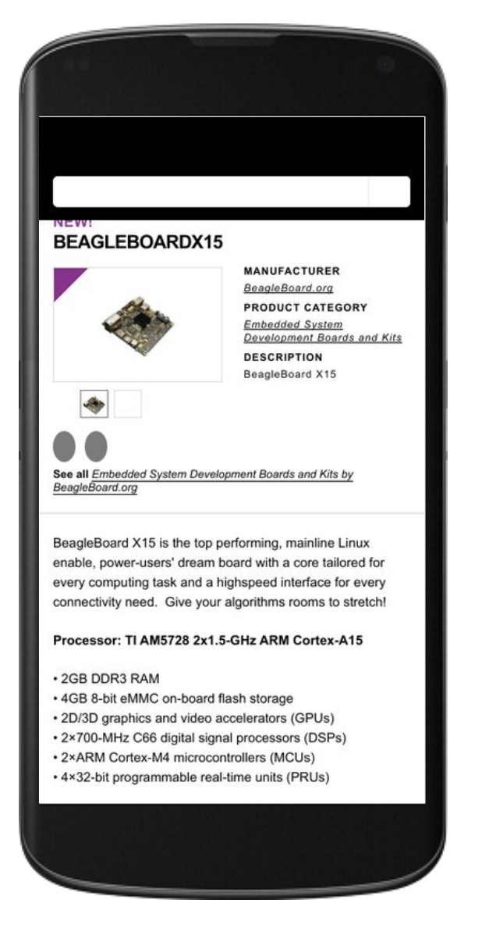
With JavaScript
Without JavaScript

Slide 39
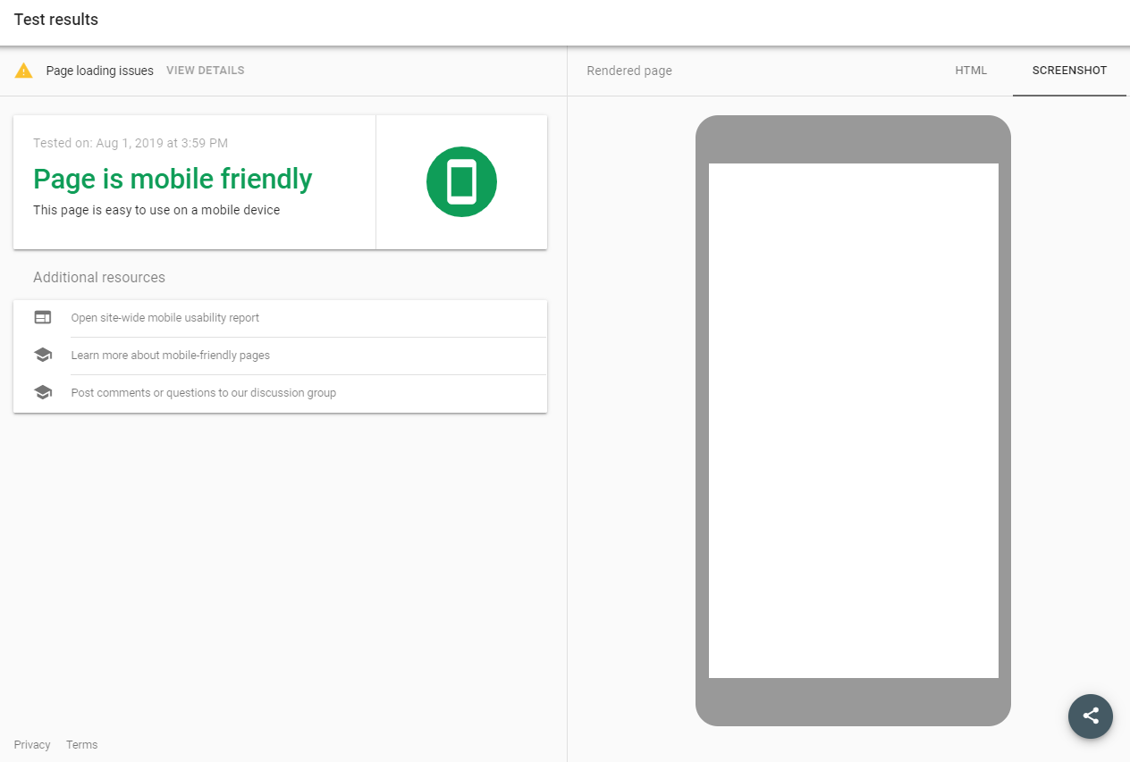
Consider how many elements trigger the creation of other elements.

Slide 40
When we have multiple scripts with a certain probability of failure, each generating content, we have content with a tendency to exist.
Notes:
Single line of copy as a statement into your next slide. You can emphasize a point in bold and dark purple (#3A0E55).
Make sure you use the font, “Poppins” throughout this deck. You’ll have been sent this but can also download for free here: https://fonts.google.com/specimen/Poppins?selection.family=Poppins:100,100i,200,200i,300,300i,400,400i,500,500i,600,600i,700,700i,800,800i,900,900i

Slide 41
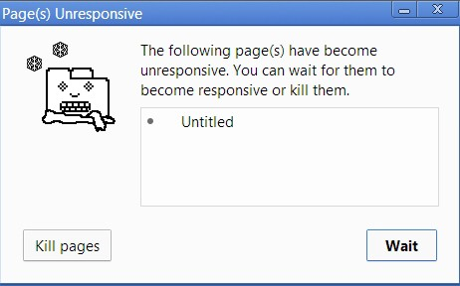
Performance matters
Google will limit CPU consumption
Google will interrupt script
Excessive CPU consumption negatively impacts indexing

Slide 42
site speed != site performance.

Slide 43
<!doctype html>
<head>
<title>Hello, TTTL
</head>
<body>
<h1>Wait.This isn’t Miami</h1>
<p>Wash your hands.</p>
</body>
</html>
Server Side Render

Slide 44
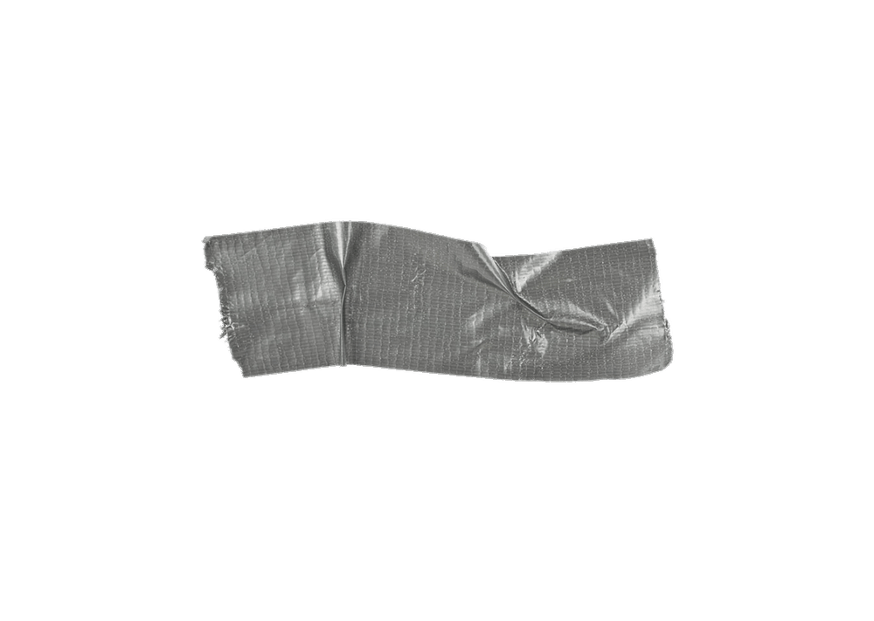

Slide 45
Prerender

Slide 46
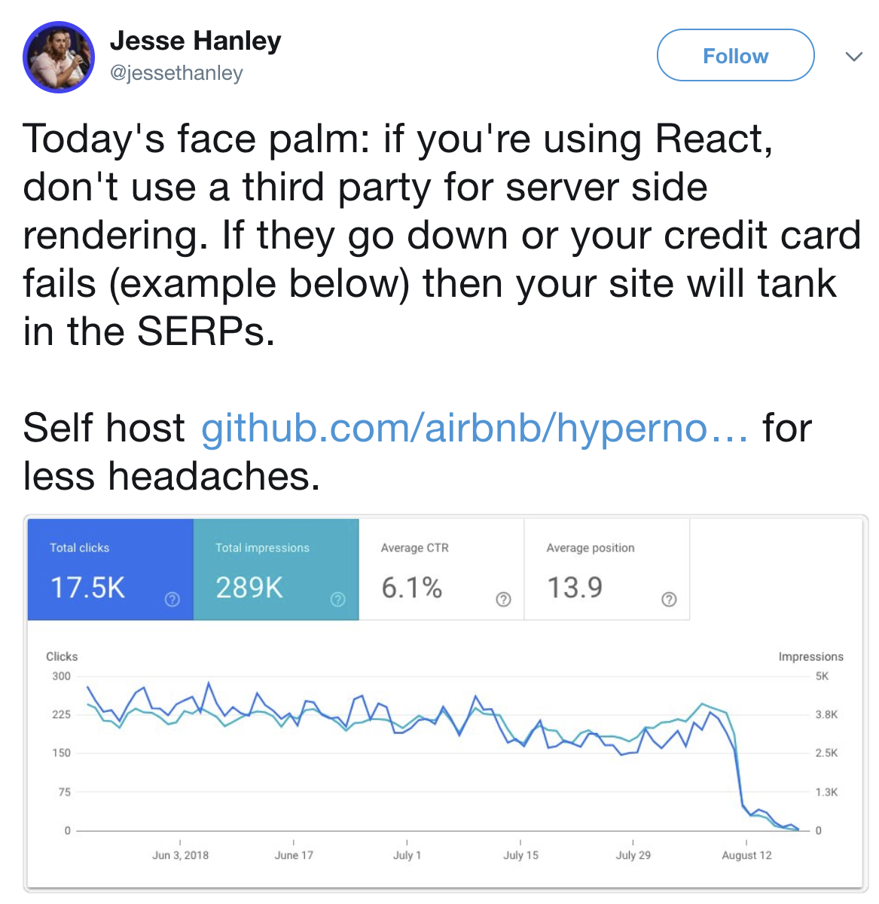

Slide 47
<!doctype html>
<head>
<title>Hello, TTTL</title>
<link rel="shortcut icon" href="//favicons/favicon-32x32.png" type="image/png" />
<link rel="canonical" href="https://www.perforce.com/blog/vcs/component-based-development" />
<!doctype html>
<head>
<script type="text/javascript" src="/main.js?ver=1.1.0"> </script>
</head>
<body>
<app-root></app-root>
</body>
</html>
Dynamic Rendering

Slide 48
=
<!doctype html>
<head>
<title>Hello, TTTL</title>
<link rel="shortcut icon" href="//favicons/favicon-32x32.png" type="image/png" />
<link rel="canonical" href="https://www.perforce.com/blog/vcs/component-based-development" />
<!doctype html>
<head>
<script type="text/javascript" src="/main.js?ver=1.1.0"> </script>
</head>
<body>
<app-root></app-root>
</body>
</html>
Dynamic Rendering

Slide 49
Are you sure? Do you have the resources to test?

Slide 50
Let’s break our content in Google’s rendering process.
Notes:
Single line of copy as a statement into your next slide.
Make sure you use the font, “Poppins” throughout this deck. You’ll have been sent this but can also download for free here: https://fonts.google.com/specimen/Poppins?selection.family=Poppins:100,100i,200,200i,300,300i,400,400i,500,500i,600,600i,700,700i,800,800i,900,900i

Slide 51
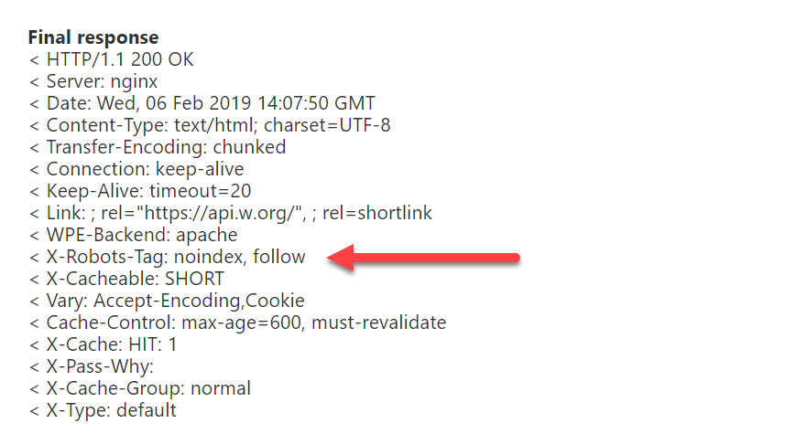
Contradictory signals
Crawl Queue
Crawler
Initial HTML
Image Credit: An SEO's Guide to Robots.txt, Wildcards, the X-Robots-Tag and Noindex

Slide 52
Undiscoverable links
Crawl Queue
<a href="/good link">Will be crawled</a>
<span onclick="changePage('bad-link')">Not crawled</span>
<a onclick="changePage('bad-link')">Not crawled</a>
<a href="/good-link" onclick="changePage ('good-link')">Will be crawled</a>
Crawler
Crawled DOM

Slide 53
Indexable API Endpoints killing your crawl stats
Crawl Queue
Resources
Crawler
Crawled DOM
Render

Slide 54
Blocked Resources and CORS errors
Crawl Queue
Resources
Crawler
Crawled DOM
Render

Slide 55
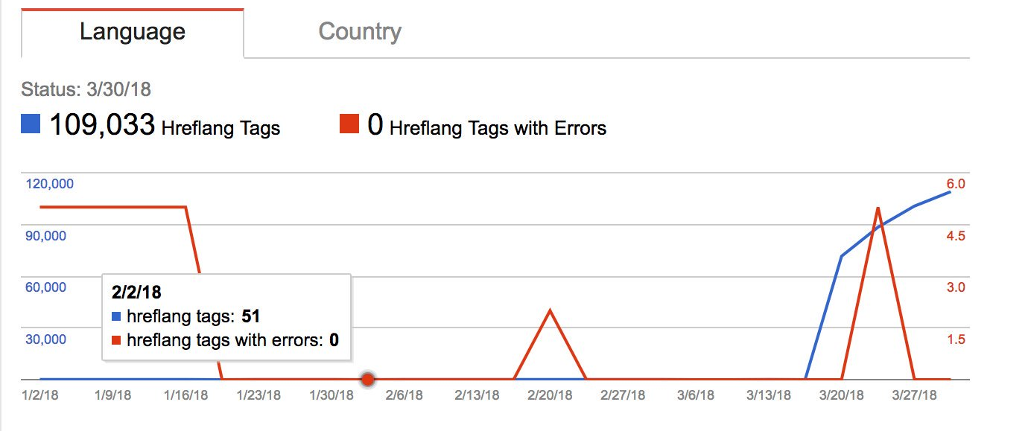
<iframes> or single points of failure in the <head>
Crawl Queue
Resources
Crawler
Crawled DOM
Render

Slide 56
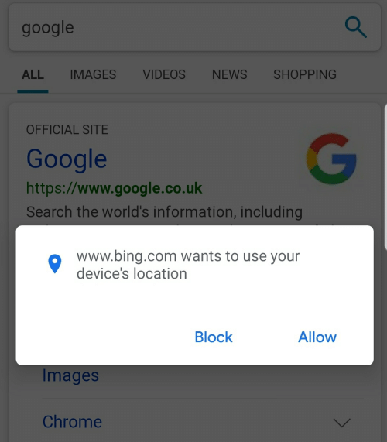
Requiring permissions or interactions
Crawl Queue
Resources
Crawler
Crawled DOM
Render

Slide 57
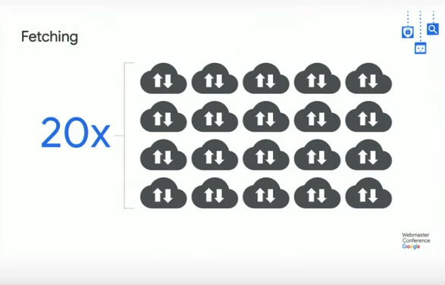
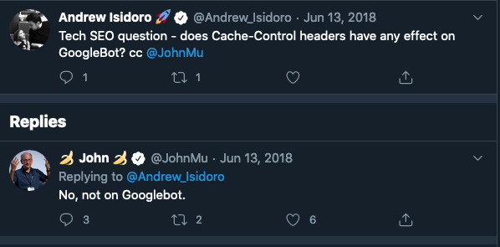
ETag and Last-Modified > Cache-control
60-70% cache rate
Crawl Queue
Resources
Crawler
Crawled DOM
Render

Slide 58
Relying on cache-control can result in bad renderings
Crawl Queue
Resources
Crawler
Crawled DOM
Render

Slide 59
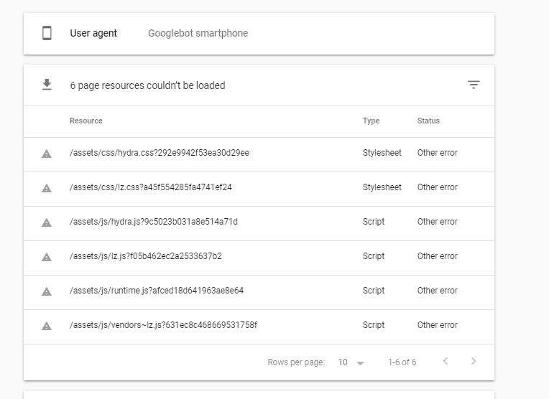
More synchronous scripts than budget
Crawl Queue
Resources
Crawler
Crawled DOM
Render
Rendered DOM

Slide 60
document.write( )
HTML, dynamic code (such as script elements containing document.write() calls) can add extra tokens, so the parsing process actually modifies the input.
Crawl Queue
Resources
Crawler
Crawled DOM
Render
Rendered DOM

Slide 61
How do we make it better?
Notes:
Single line of copy as a statement into your next slide.
Make sure you use the font, “Poppins” throughout this deck. You’ll have been sent this but can also download for free here: https://fonts.google.com/specimen/Poppins?selection.family=Poppins:100,100i,200,200i,300,300i,400,400i,500,500i,600,600i,700,700i,800,800i,900,900i

Slide 62
SEO for JavaScript frameworks requires
Visibility Can I see and reproduce what is happening?

Slide 63
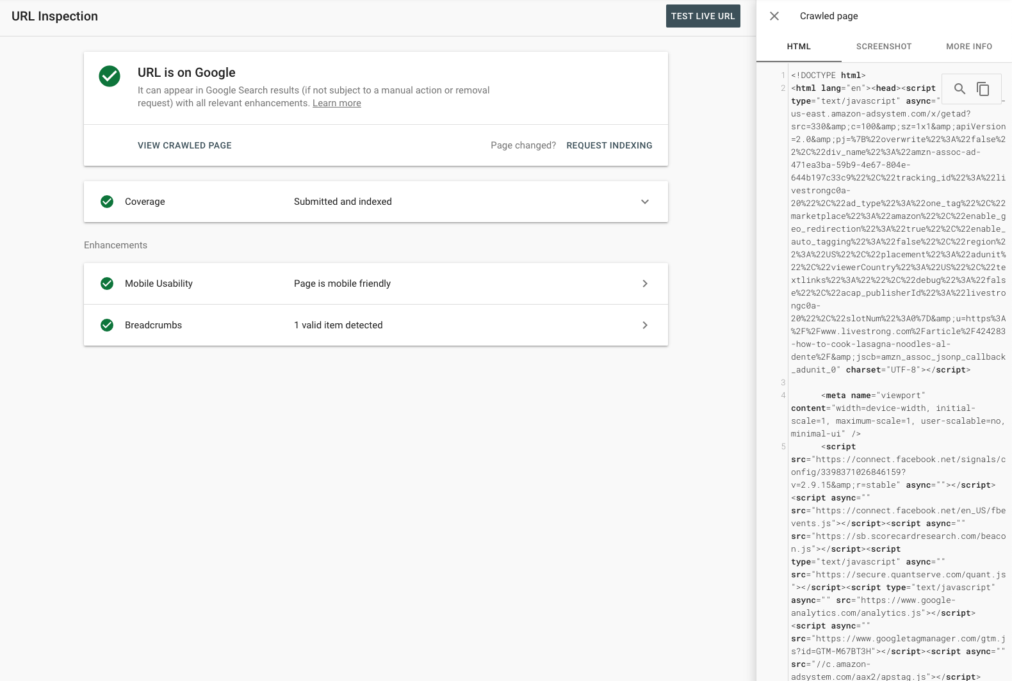
Is Google seeing all the expected content?

Slide 64
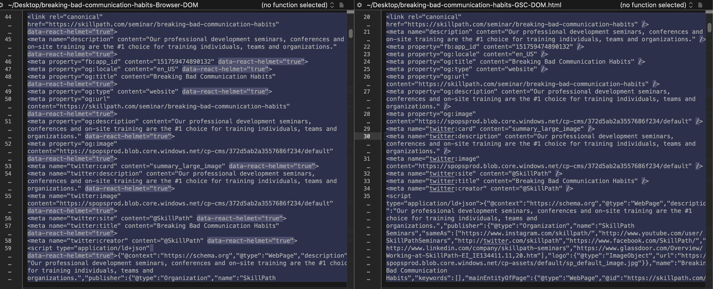
Spot the differences

Slide 65
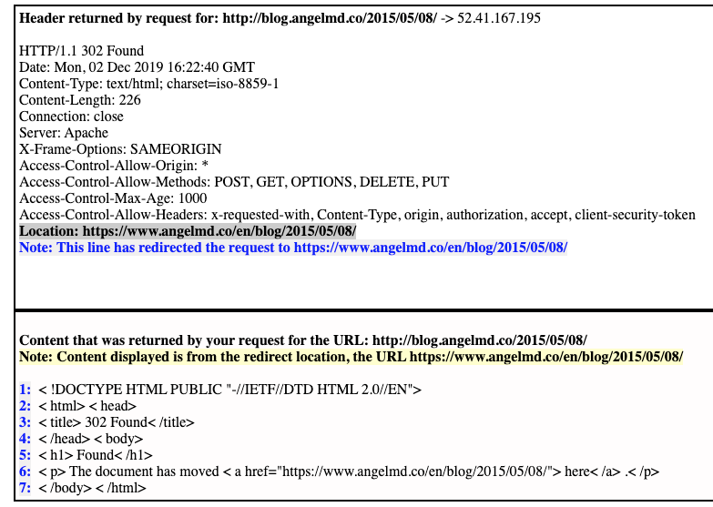
Use meaningful status codes

Slide 66
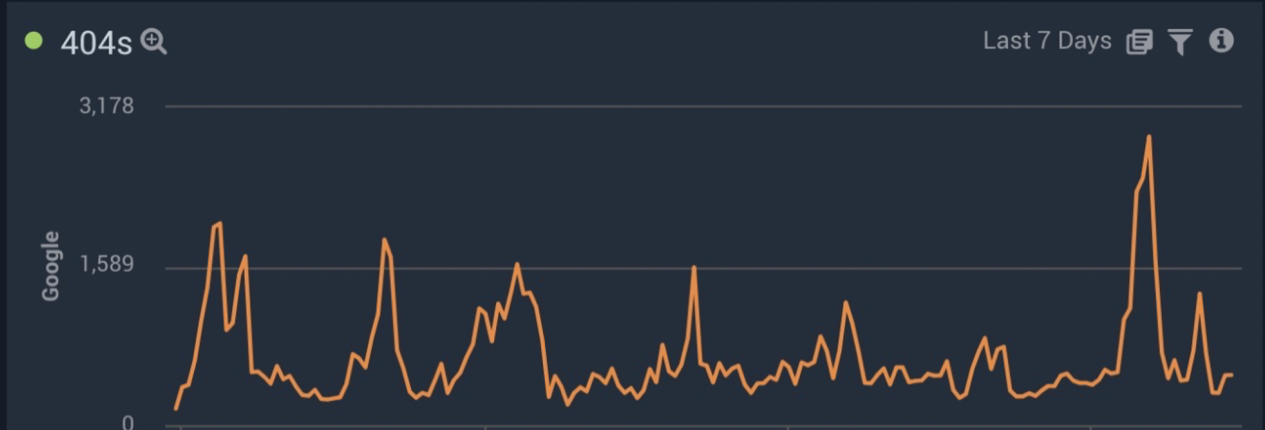
You’ll need them later.

Slide 67
Update URLs with history.pushState()

Slide 68
Track analytics with virtual pageviews

Slide 69
SEO for JavaScript frameworks requires
Visibility Can I see and reproduce what is happening?
Diagnostics Can I measure what is happening?

Slide 70
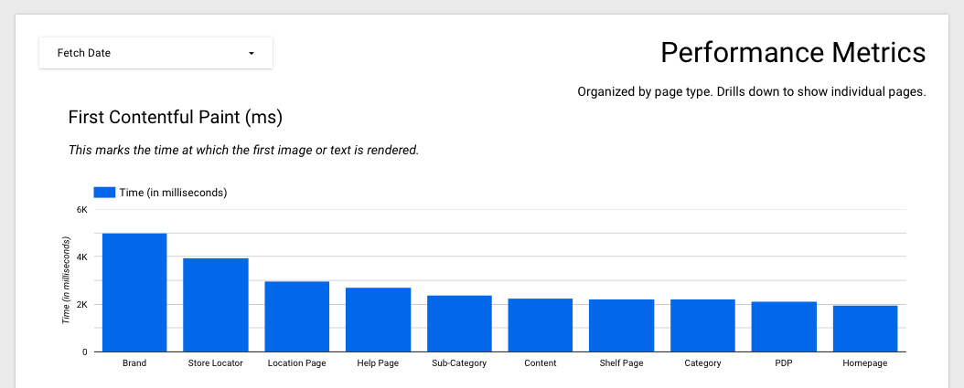
Is performance consistent?

Slide 71
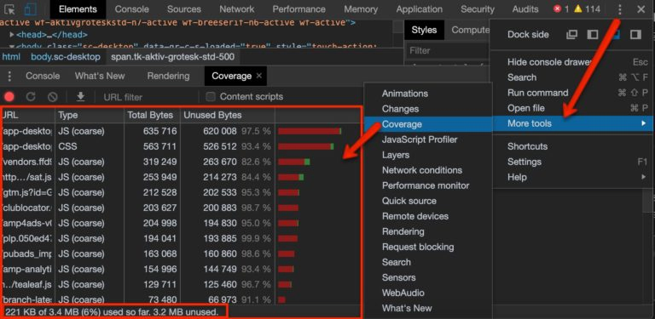
Is all the script shipped useful?

Slide 72
rankings? Sure. Why not 🤷‍♀️
Notes:
Single line of copy as a statement into your next slide.
Make sure you use the font, “Poppins” throughout this deck. You’ll have been sent this but can also download for free here: https://fonts.google.com/specimen/Poppins?selection.family=Poppins:100,100i,200,200i,300,300i,400,400i,500,500i,600,600i,700,700i,800,800i,900,900i

Slide 73
SEO for JavaScript frameworks requires
Visibility Can I see and reproduce what is happening?
Diagnostics Can I measure what is happening?
Iteration Can take meaningful steps to improve it?

Slide 74
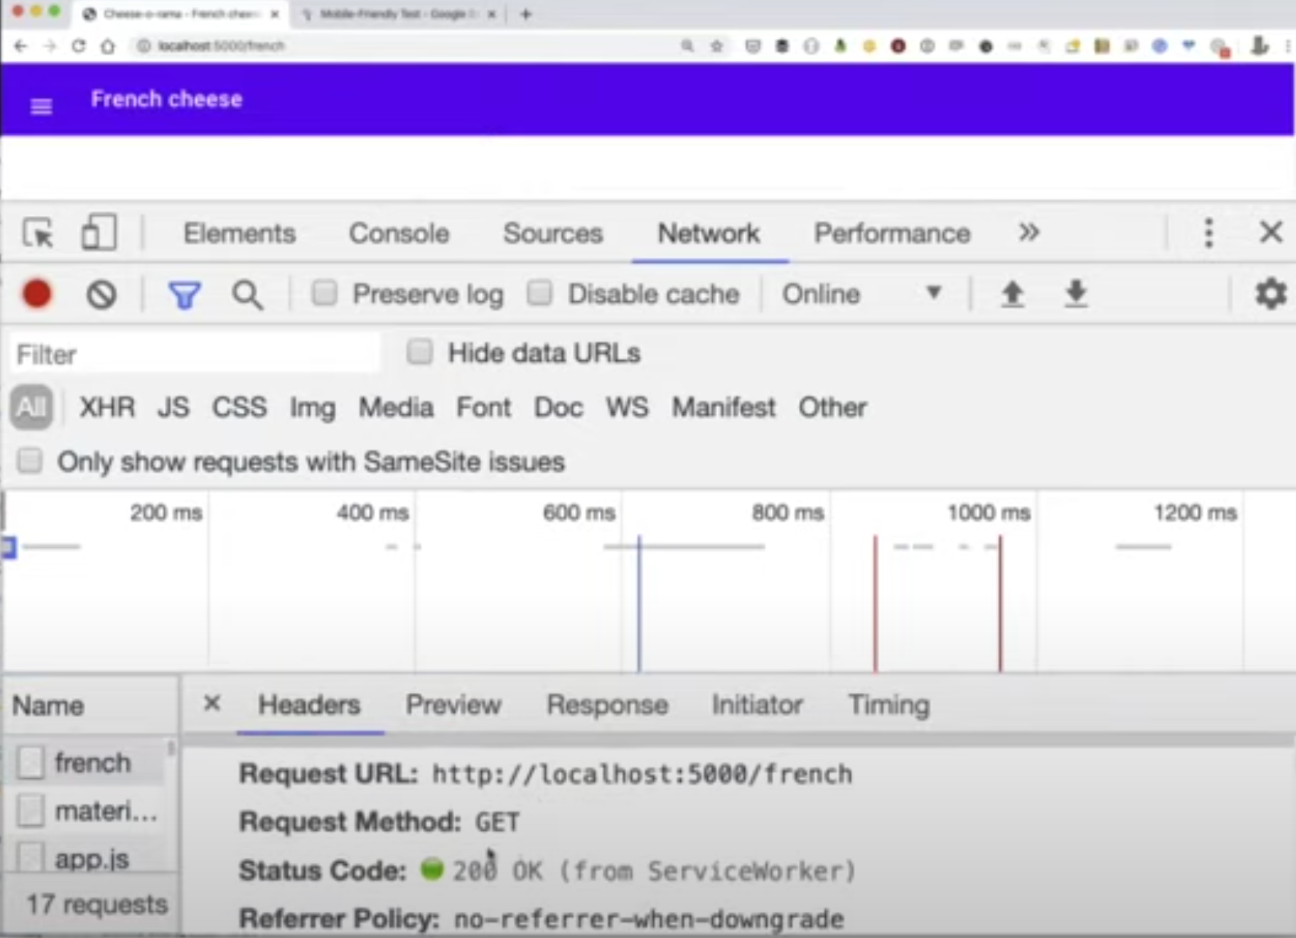
Have a fallback plan in your code
Source: Better Together virtual conference - technical SEO learnings during the COVID-19 Crisis

Slide 75
Judiciously review 3rd party JS
Meta Tag: Charset
Meta Tag: Viewport
Meta Tag: Http-Equiv
Meta Tag: Theme-Color
Verification: Google
Manifest: /Manifest.Json
Favicon: /Favicon.Ico
Stylesheet: https://fonts.googleapis.com/
Stylesheet: https://stackpath.bootstrapcdn.com/
Stylesheet: https://cdnjs.cloudflare.com/
Stylesheet: https://use.fontawesome.com/
Javascript: https://d10lpsik1i8c69.cloudfront.net
Javascript: https://sjs.bizographics.com/
Javascript: https://sjs.bizographics.com/
Javascript: //bat.bing.com/bat.js
Javascript: //www.googleadservices.com/
Javascript: https://www.google-analytics.com/
Javascript: https://www.google-analytics.com/
Javascript: connect.facebook.net
Javascript: connect.facebook.net
Javascript: https://connect.facebook.net/
Javascript: https://www.google-analytics.com/
Javascript: https://www.googletagmanager.com/
Javascript: https://code.jquery.com/
Javascript: cdn.jsdelivr.net
Javascript: https://stackpath.bootstrapcdn.com/
Javascript: https://7204573.collect.igodigital.com/
Meta Tag: Title
Function: https://static.hotjar.com/
Javascript: https://static.hotjar.com/
Function: https://www.googletagmanager.com/
Function: https://www.google-analytics.com/
Function: https://connect.facebook.net/
Javascript: /settings.js
Function: appInsights
Stylesheet: 2.80a51d23.chunk.css
Stylesheet: main.f61b0538.chunk.css
Javascript: https://az416426.vo.msecnd.net/

Slide 76
Leveraging Chrome’s native lazy-loading functionalities
<rel="supplementarycontent.js" async>
<rel="footer.js" defer>
<img src=”the-traveler.jpg” loading=”lazy”>

Slide 77
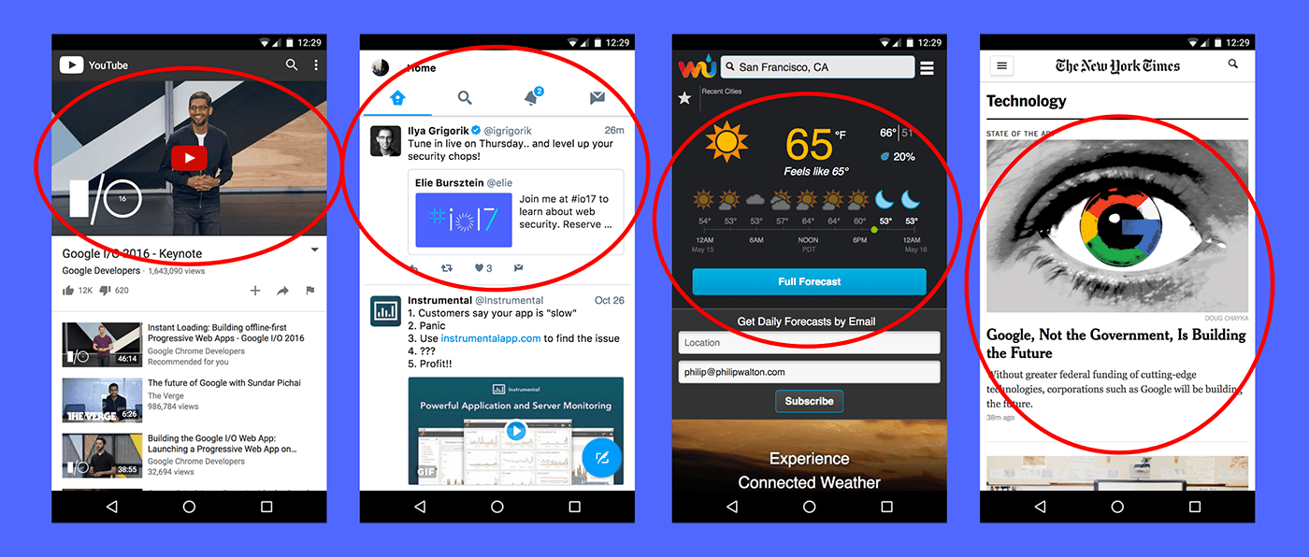
Load what matters to your users when it matters to them.

Slide 78
Make Allies
Go to development stand up meetings
Learn how to write thorough and useful tickets
QA SEO tickets!!
Get hands on with code in Google’s Codelab
Learn to speak dev (start with the developer’s guide to search)
Join the JavaScript Working Group
Watch Google’s JavaScript SEO web series

Slide 79
|￣￣￣￣￣￣￣￣￣￣￣￣|
LEARN FROM EACH OTHER
& BE KIND TO EACH OTHER
|＿＿＿＿＿＿＿＿＿＿＿＿|
(\__/) ||
(•ㅅ•) ||
/ づ
Notes:
Single line of copy as a statement into your next slide.
Make sure you use the font, “Poppins” throughout this deck. You’ll have been sent this but can also download for free here: https://fonts.google.com/specimen/Poppins?selection.family=Poppins:100,100i,200,200i,300,300i,400,400i,500,500i,600,600i,700,700i,800,800i,900,900i

